Slide 1
ELDER ABUSE PREVENTION
ACROSS THE GENERATIONS
Ageism and Abuse

Slide 2

Definition
Discrimination against older adults because they are older
Harmless phrases:
“You don't look (your age)!”
“60 is the new 40.”
“Nobody says that anymore.”
You stayed awake until midnight? Good for you!“
“You should be retired by now.”
“Slow down, Grandpa!”

Slide 3
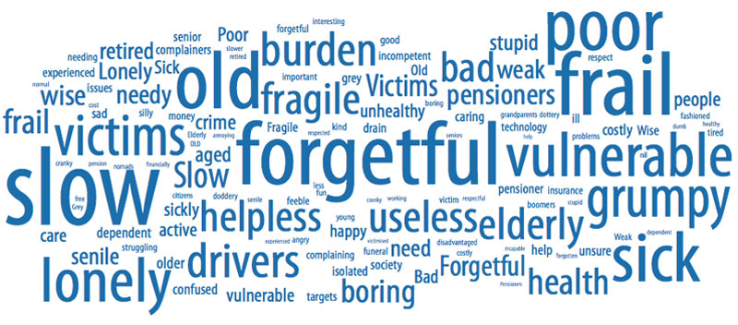
Words Can Hurt

Slide 4
Statistics
6 in 10 (63%) of seniors say they have been treated unfairly / differently because of age
8 in 10 (79%) agree seniors are seen as less important
1 in 5 (21%) see older Canadians as a burden

Slide 5

https://youtu.be/lYdNjrUs4NM

Slide 6
Psychological / Physical Effects
Ageism has real mental and physical health consequences, including:
decreased will to live
less desire to live a healthy lifestyle
impaired recovery from illness
increased stress
shortened life span

Slide 7
Ageism & Abuse
Ageism is a type of prejudice that both justifies abusive behaviour against older people and leads to overlooking the consequences it has on older people.
Adult children start to make decisions for their parents/grandparents
Young people think older adults are taking their jobs

Slide 8
“It’s Not Right!” Neighbours, Friends and Families for Older Adults
People
More at Risk?
20% of Trans seniors have
been physically or sexually
abused for being Trans
LGBTQ+ seniors may face
social discrimination
due to their age as well as their
sexual orientation or
gender identity
women with
disabilities are 4x more likely to
be sexually assaulted
Ongoing legacy of residential schools
and colonization - indigenous
people are 6x
more likely to be killed
Men are more likely
to be victims of Ageism
in the workforce
“time to get out of the way”
Notes:
LGBT stats – Rainbow Health Ontario http://www.rainbowhealthontario.ca/
Stats Canada 2014 – homicide rates of indigenous people
Women with disabilities – Canadian Women’s Foundation http://www.canadianwomen.org/node/2867

Slide 9
How you can help
Be watchful
Recognize the warning signs
Ask questions
Listen carefully
Be supportive – let them tell you what they need
Investigate and share local resources

Slide 10
Safe Responses
If someone tells you they are being abused, here are some helpful things you can say:
‘I believe you.”
“It’s not your fault.”
“I’m worried about your safety.”
“I will support you and your decisions.”
“How can I help?”

Slide 11

Signal For Help
If you see someone use the Signal for Help, check in with the person safely to find out what they need and want you to do.
If you or someone you know is in immediate danger, call 911 or your local emergency services (police, fire, ambulance).
Canadian Women’s Foundation

Slide 12
Safety Planning
It is important to protect your personal documents and think about what to do in case of an emergency. You may want to consider putting together an emergency kit that includes:
Emergency phone number such as family, neighbour, shelter
Cash/ Extra clothing/ glasses/ hearing aides/ assisted devices
List of medications with at least 3 days worth and pharmacy phone number
Copies of important documents/ identification/ SIN/ Passport/ health card/ house key/ banking information
Above all, identify a SAFE PLACE TO GO IN and OUTSIDE OF THE HOUSE as well as an ESCAPE ROUTE

Slide 13
“It’s Not Right!” Neighbours, Friends and Families for Older Adults
Imminent Danger 911
Resources – finding help
211Ontario 211
Seniors’ INFO line 1-888-910-1999
Elder Abuse Prevention ON 416-916-6728
www.eapon.ca
Prevention of Senior Abuse Network Simcoe County
www.psan-sc.ca
Prevention of Elder Abuse Committee of York Region www.elderabuse-yorkregion.ca
CHATS-Community & Home Assistance to Seniors
(Caregiver Support Team) 1-877-452-4287 www.chats.on.ca
Notes:
You can add a slide to insert local contact information for services and organizations that support seniors in your area.

Slide 14
“It’s Not Right!” Neighbours, Friends and Families for Older Adults
Additional Resources:
Imminent Danger Call 911
Ontario Caregiver Helpline 1.833.416.2273
Law Society Referral Service 1-855-947-5255
Legal Aid Ontario 1-800-668-8258
Seniors Safety Line 1-866-299-1011
Ontario Crime Stoppers 1-800-222-8477
South Simcoe Police 905-775-3311
OPP Alliston 705 434-1939
York Regional Police 1-866-876-5423 ext. 6697
Victim Support Line 1-888-579-2888
Notes:
You can add a slide to insert local contact information for services and organizations that support seniors in your area.

Slide 15

“It’s Not Right!”

Slide 16


