Slide 1
ELDER ABUSE PREVENTION
ACROSS THE GENERATIONS
Financial Abuse

Slide 2
Definition
Mistreatment and/or fraud in which someone forcibly controls another person's money or other assets.
It can involve, for instance, stealing cash, not allowing a victim to take part in any financial decisions or preventing a victim from having a job.

Slide 3
Statistics
Financial abuse is the most common form of elder abuse in Canada
67% of suspected senior financial abuse in Canada goes unreported
1 in 10 seniors is a victim of crime each year
64% of victims know their abuser
www.Canada.ca/en/employment-social-development

Slide 4
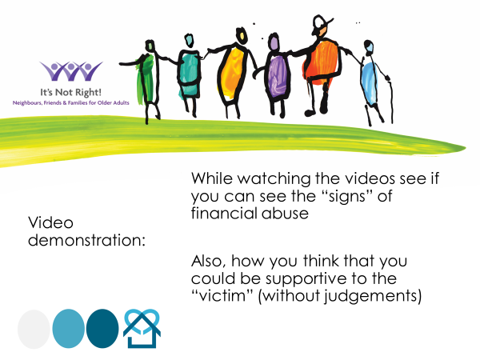
Notes:
The video is used with permission by It’s Not Right! Neighbours, Friends and Families of Older Adults, The Centre for Research and Education on Violence Against Women and Children, Western University.

Slide 5
People at Risk
Living alone
Dependent on others
Physically disabled
Cognitive disabilities (diagnosed or undiagnosed)
Those who are naïve / trusting of others
Those involved in predatory Marriages

Slide 6
Warning Signs
Your bank statements show account withdrawals or transfers you did not make
A trusted person suggests that you make changes to important contracts (Will, Power of Attorney, Property Titles, Mortgages) that you do not want to make and are not in your best interest
You feel afraid of or pressured by a trusted person to give “join authority” or “gifting” of assets under the assumption that taxes will be saved when you expire

Slide 7
Video demonstration:
While watching the videos see if you can see the “signs” of financial abuse
Also, how you think that you could be supportive to the “victim” (without judgements)

Slide 8
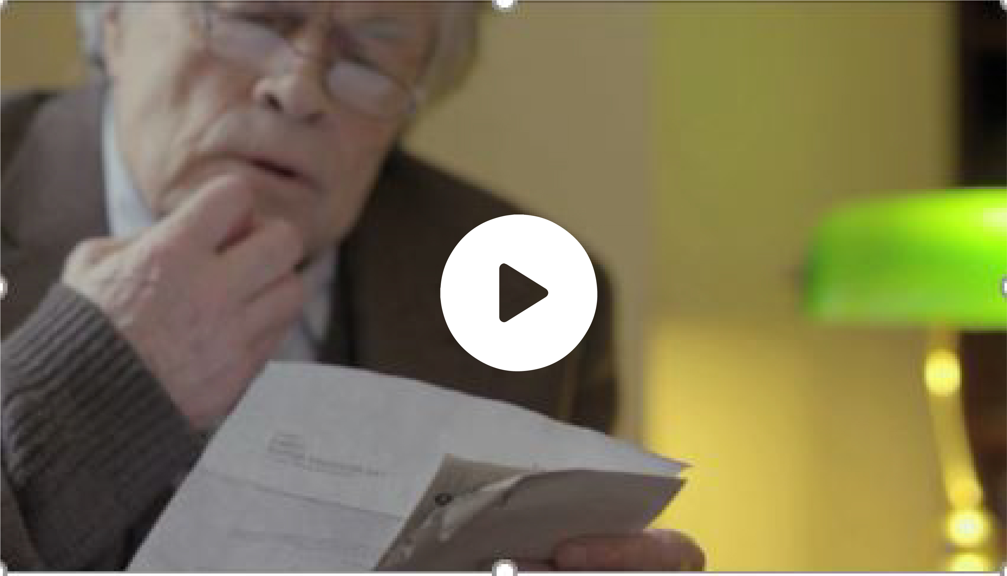
https://youtu.be/BuSfF_ar3GQ

Slide 9
What did you observe?
Discussion time…

Slide 10
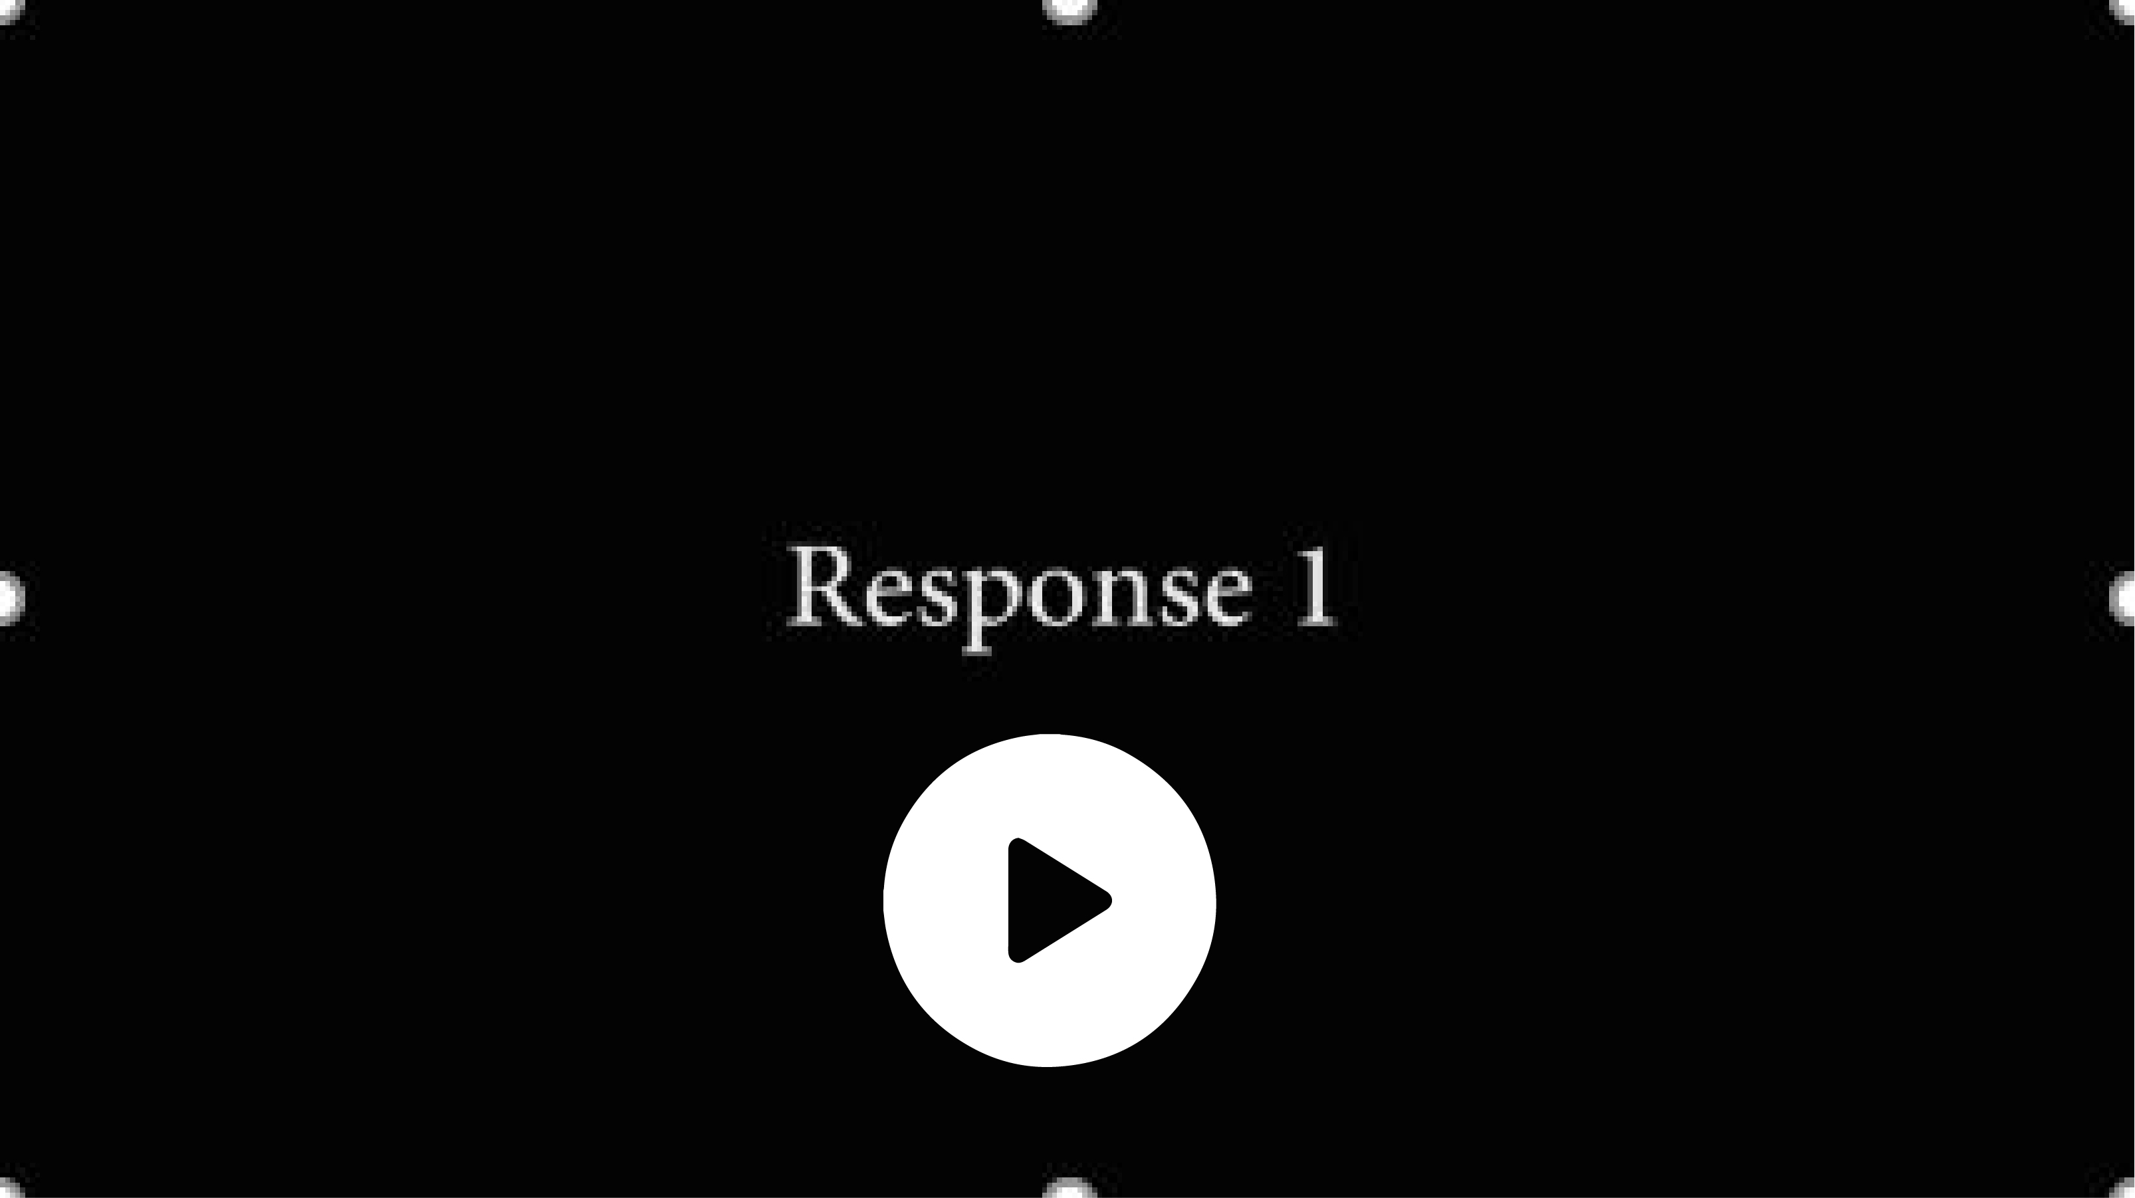
https://youtu.be/n1-82KW71zI

Slide 11
Response One:
Discussion time…

Slide 12
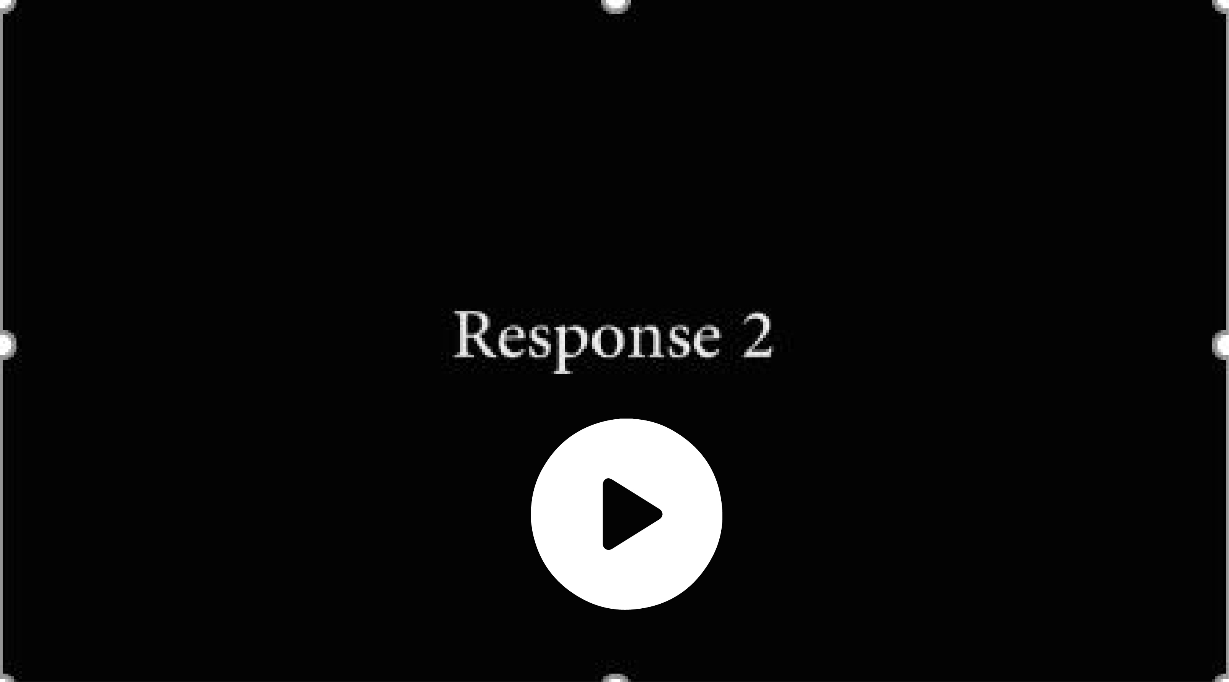
https://youtu.be/_eLuM0idte0

Slide 13
Response Two:
Please discuss…

Slide 14

Preventing
Financial Abuse
Keep your financial and personal information in a safe place, and never give anyone your bank-card PIN.
If you lend someone money, write down the person’s name, the amount, and the date of loan; ask the person to sign this document.
Keep in touch with a variety of friends and family so you don't become isolated
Keep a file of your accounts and legal documents, and keep a record of financial transactions and changes to legal documents
if you give over your Power of Attorney for Finance have your lawyer add an addendum stating that you must approve, in writing, all transactions

Slide 15
Psychological / Physical Effects
Undermines trust in loved ones
Leads to isolation
Creates extreme anxiety or guilt when using money
Causes some to go without food and other necessities because they have no money
Leaves victims vulnerable to physical abuse and violence

Slide 16
How you can help
Be watchful
Recognize the warning signs
Ask questions
Listen carefully
Be supportive – let them tell you what they need
Investigate and share local resources

Slide 17
Safe Responses
If someone tells you they are being abused, here are some helpful things you can say:
“I believe you.”
“It’s not your fault.”
“I’m worried about your safety.”
“I will support you and your decisions.”
“How can I help?”

Slide 18

Signal For Help
If you see someone use the Signal for Help, check in with the person safely to find out what they need and want you to do.
If you or someone you know is in immediate danger, call 911 or your local emergency services (police, fire, ambulance).
Canadian Women’s Foundation

Slide 19
Safety Planning
It is important to protect your personal documents and think about what to do in case of an emergency. You may want to consider putting together an emergency kit to include:
Emergency phone numbers such as friends, family, shelter
Cash/ Extra clothing/ glasses/ hearing aides/ assisted devices
List of medications with at least 3 days worth and pharmacy phone number
Copies of important documents/ identification/ SIN/ Passport/ health card/ house key/ banking information
Above all, identify a SAFE PLACE TO GO IN and OUTSIDE OF THE HOUSE as well as an ESCAPE ROUTE

Slide 20
Elder Abuse, is it a Crime?
Systemic Abuse (or institutional abuse)
Violations of Rights and Freedoms
If somebody interferes with an older adult’s ability to make choices, especially when those choices are protected under the law.
  Interfering with spiritual practices or traditions
  Withholding mail or information
  Denying privacy
  Prevention of visitors
  Dictating how someone else can spend their own money
  Keeping someone in an institution without a legitimate reason
Refers to rules, regulations, policies or social practices that harm or discriminate against older adults.
  Rules that are developed for an apparently neutral purpose, but that hurt the person
  Using physical restraints as an easy way to prevent falls when not necessary
  Putting a brief on a person instead of helping them to the washroom to save time or effort
  Staff shortages or lack of staff training (neglect)

Slide 21
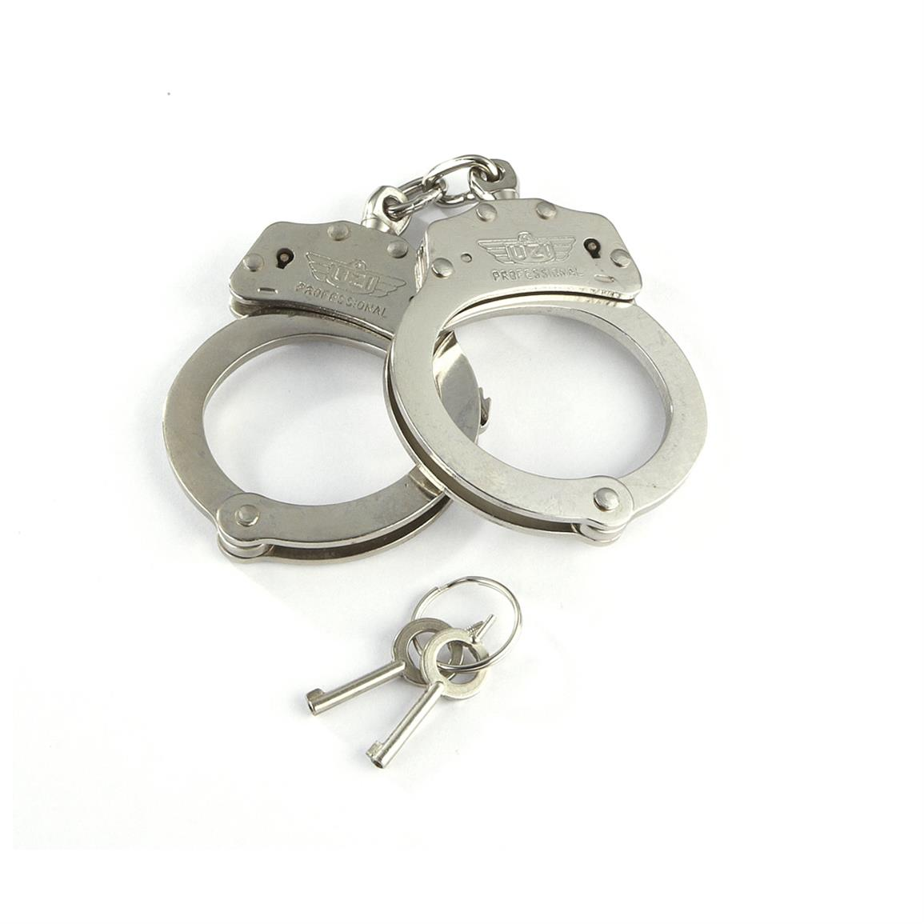
Elder Abuse is a Crime
Canada’s Criminal Code allows for the following charges in relation
to Elder Abuse:
Fraud Sec. 380
Harassment Sec. 264
Assault Sec. 266
Intimidation Sec. 423
Fail to provide necessity of life Sec. 215
Forcible confinement Sec. 279
Unlawful confinement Sec. 279
Uttering forged documents Sec. 368 (1)
Assault with a weapon Sec. 267
Threats Sec. 264.1
Theft Sec. 332 (1)
Theft by Power of Attorney Sec. 331
Manslaughter Sec. 236
Sexual Assault Sec. 271

Slide 22
“It’s Not Right!” Neighbours, Friends and Families for Older Adults
Imminent Danger 911
Resources – finding help
211Ontario 211
Seniors’ INFO line 1-888-910-1999
Elder Abuse Prevention ON 416-916-6728
www.eapon.ca
Prevention of Senior Abuse Network Simcoe County
www.psan-sc.ca
Prevention of Elder Abuse Committee of York Region www.elderabuse-yorkregion.ca
CHATS-Community & Home Assistance to Seniors
(Caregiver Support Team) 1-877-452-4287 www.chats.on.ca
Notes:
You can add a slide to insert local contact information for services and organizations that support seniors in your area.

Slide 23
“It’s Not Right!” Neighbours, Friends and Families for Older Adults
Additional Resources:
Imminent Danger Call 911
Ontario Caregiver Helpline 1.833.416.2273
Law Society Referral Service 1-855-947-5255
Legal Aid Ontario 1-800-668-8258
Seniors Safety Line 1-866-299-1011
Ontario Crime Stoppers 1-800-222-8477
South Simcoe Police 905-775-3311
OPP Alliston 705 434-1939
York Regional Police 1-866-876-5423 ext. 6697
Victim Support Line 1-888-579-2888
Notes:
You can add a slide to insert local contact information for services and organizations that support seniors in your area.

Slide 24

“It’s Not Right!”

Slide 25


